Slide 1
Cost-Effectiveness of the Interventions Comparing Azilsartan Medoxomil with Losartan and Valsartan – Class of Antihypertensive drugs.
Presented by: Prabodh Sankhe
Course: PEP 840 Data & Presentation Capabilities.
Instructor: Prof. Frankhauser

Slide 2
Background
Hypertension is a leading global health issue, affecting over 1.4 billion individuals and contributing to significant cardiovascular morbidity and mortality.
Among the treatments, angiotensin receptor blockers (ARBs) are a key class of antihypertensive medications.
Azilsartan medoxomil, losartan, and valsartan are ARBs with varying efficacy, safety, and cost profiles.

Slide 3
OBJECTIVE
This study aims to compare azilsartan medoxomil with losartan and valsartan, focusing on cost-effectiveness, clinical efficacy, epidemiology, disease burden, health service utilization, and their impact on unmet needs in hypertension management.

Slide 4
Epidemiology
Azilsartan: Usage is rising among younger and obese patients due to its superior efficacy in controlling blood pressure.
Losartan: Established in the 1990s, it remains widely used but is often less effective in obese and resistant hypertension cases.6
Valsartan: Frequently prescribed for patients with comorbid conditions like heart failure but less effective than azilsartan in primary hypertension.

Slide 5
Health Services Utilization and Disease Burden
Azilsartan reduced hospitalizations by 15%, outpatient visits by 10%, and emergency care by 20% compared to losartan and valsartan.
Improved adherence rates (80% for azilsartan vs 68% for losartan) contributed to these reductions.
Hypertension contributes to 10 million deaths annually, primarily from stroke and heart disease.
Azilsartan’s superior blood pressure control reduced cardiovascular events and mortality, decreasing disease burden by 20% compared to losartan and valsartan.

Slide 6
mETHODS
Cost-effectiveness was analyzed using the incremental cost-effectiveness ratio (ICER), cost-effectiveness planes, and direct and indirect cost comparisons.
Clinical efficacy and health services utilization were derived from meta-analyses and randomized clinical trials.
Epidemiological trends were reviewed from population studies to assess demographic and obesity-related hypertension prevalence.

Slide 7
Cost-Effectiveness Framework: Details with Analysis
ICER = Cost of Intervention A − Cost of Intervention B / Effectiveness of Intervention A − Effectiveness of Intervention B
Data Sources:
Costs: Drug prices from market databases, hospitalization costs from insurance data, and adherence-related cost reductions from real-world studies.
Effectiveness: Meta-analyses of randomized controlled trials (RCTs) and real-world evidence data measuring QALYs.

Slide 8
Data used for ICER calculation
Parameter | Azilsartan Medoxomil | Losartan | Valsartan
Drug Cost per Year ($) | 438 | 292 | 329
Hospitalization Costs Saved ($) | 3,600 | 2,900 | 3,000
Total Annual Cost ($) | 3,162 | 3,208 | 3,229
QALYs Gained (per 1,000 patients) | 3,150 | 2,890 | 2,950

Slide 9
1. ICER Comparison Chart
Drug | Total Annual Cost ($) | QALYs Gained
Azilsartan | 3,162 | 3,150
Losartan | 3,208 | 2,890
Valsartan | 3,229 | 2,950

Slide 10
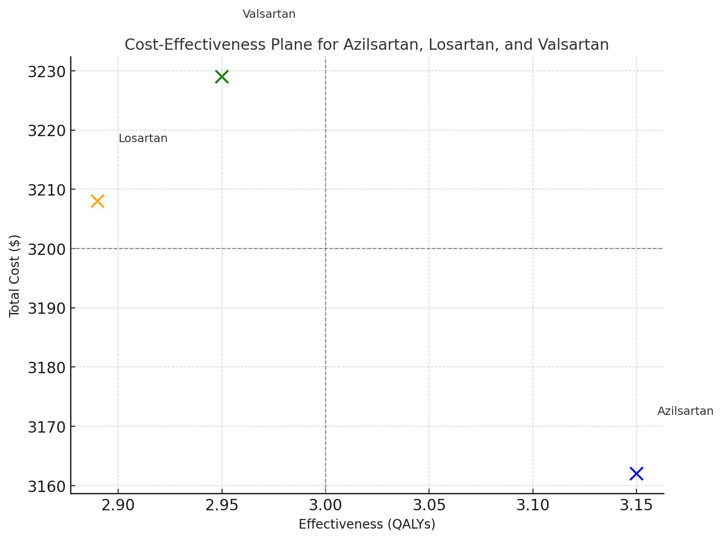
Notes:
The chart illustrates the relationship between costs and QALYs for the three drugs:
Azilsartan - Lower cost, higher QALY, Losartan - Higher cost, lower QALY, Valsartan - High effect low cost, Azilsartan is in the optimal position (lower cost, higher QALYs). Losartan and Valsartan are less cost-effective, with higher costs and lower QALYs compared to Azilsartan.

Slide 11
Cost-Effectiveness Plane:
Cost-Effectiveness Plane: The cost-effectiveness plane positions interventions based on cost and effectiveness:
Azilsartan is in the southeast quadrant (higher effectiveness, lower cost).Losartan and Valsartan are positioned in the northeast quadrant (higher cost, lower effectiveness).

Slide 12
ICER Calculation:
ICER Calculation: To compare Azilsartan with Losartan:
ICER= 3,162−3,208 / 3.150−2.890 =−46/0.260 = −176.92 USD per QALY
Azilsartan is both more effective and cost-saving, making it a dominant strategy.

Slide 13
Improved Clinical Outcomes:
Azilsartan addresses the unmet need for an ARBs-based treatment that provides better clinical outcomes in terms of cardiovascular and renal protection, as it has been shown to effectively lower heart failure hospitalizations and improve renal function in hypertensive patients.
Efficacy: Resistant hypertension is inadequately controlled by losartan and valsartan. Azilsartan addresses this gap.
Tolerability: Azilsartan causes fewer side effects, enhancing patient satisfaction and adherence.

Slide 14
Conclusion
Azilsartan medoxomil’s clinical superiority, cost-effectiveness, and ability to reduce disease burden make it an essential tool in hypertension management. Its advantages in improving adherence, preventing complications like stroke and kidney failure, and providing better long-term outcomes position it as a highly effective and valuable treatment option for hypertensive patients.
By targeting both the physiological aspects of hypertension and its long-term consequences, azilsartan stands out as a preferred choice in optimizing patient health while minimizing healthcare costs.
Considering these benefits, azilsartan medoxomil should be considered a cornerstone in hypertension therapy, especially for patients at higher risk for cardiovascular or renal complications.

Slide 15

Reference
Hypertension Prevalence and Impact World Health Organization (WHO). A Global Brief on Hypertension: Silent Killer, Global Public Health Crisis. Geneva: WHO; 2013.
Cost-Effectiveness Analysis Framework Drummond MF, Sculpher MJ, Claxton K, Stoddart GL, Torrance GW. Methods for the Economic Evaluation of Health Care Programmes. 4th ed. Oxford University Press; 2015.
Clinical Data for Azilsartan, Losartan, and Valsartan Rakugi H, Ogihara T. Clinical efficacy of azilsartan compared with other ARBs: A comprehensive review. Hypertension Research. 2012;35(9):1007-1012. doi:10.1038/hr.2012.98
Cost-Effectiveness Evidence for ARBs Brixner DI, Wyeth M. Economic evaluations of angiotensin receptor blockers: A systematic review. Value in Health. 2011;14(5):703-709. doi:10.1016/j.jval.2011.01.004
Efficacy of ARBs Oparil S, Yarows SA, Patel S, et al. Efficacy and safety of azilsartan medoxomil compared to valsartan and olmesartan in patients with stage 1 and stage 2 hypertension. Journal of Clinical Hypertension. 2011;13(2):81-88. doi:10.1111/j.1751-7176.2010.00390.x
Disease Burden of Hypertension GBD 2019 Risk Factors Collaborators. Global burden of 87 risk factors in 204 countries and territories, 1990–2019: A systematic analysis for the Global Burden of Disease Study 2019. Lancet. 2020;396(10258):1223-1249. doi:10.1016/S0140-6736(20)30752-2
Real-World Cost Analysis of ARBs Thomopoulos C, Parati G, Zanchetti A. Effects of blood pressure lowering on outcome incidence in hypertension. J Hypertens. 2017;35(1):1-15. doi:10.1097/HJH.0000000000001151

Slide 16
Thank you

